Slide 1





Bayesian Graphical Modeling
Network Comparisons
PsyNets Winterschool 2026
m.marsman@uva.nl
bayesiangraphicalmodeling.com

Slide 2
Setup Today
Estimating & Testing
Network Comparison
Clustering
Morning Session
Afternoon Session

Slide 3
Setup Today
Estimating & Testing
Network Comparison
Clustering
Morning Session
Afternoon Session

Slide 4
Setup Today
Estimating & Testing
Network Comparison
Clustering
Morning Session
Afternoon Session

Slide 5




Session setup
Part I: Theory
Part II: Practical
Part III: Project
image: Flaticon.com

Slide 6
Session setup
Part I: Theory
image: Flaticon.com

Slide 7
Why Compare Networks?

Slide 8
Why Compare Networks?
Assess network variance or invariance
Do network structures (response behavior) differ between groups?
Which relations are stable (invariant) across groups?
Where do key differences emerge?
This is a psychometric approach, very similar to questions about differential item functioning or measurement invariance in IRT/SEM frameworks.

Slide 9
Why Compare Networks?
Assess network variance or invariance
Reproducibility
Do network results reproduce in different samples?
Do network results generalize to different populations?
A central motivation for developing Bayesian approaches to group comparisons is the concern about reproducibility in network psychometrics.
This is a methodological approach, aiming to distinguish signal from noise.

Slide 10
Why Compare Networks?
Assess network variance or invariance
Reproducibility
Asses theoretical predictions
Do empirical networks match theoretical expectations?
For example, expected subgroup differences (e.g., involvement)
Network models are not only descriptive; they can also be used to formalize and test theories. This offers a substantive perspective to network comparison.

Slide 11
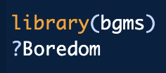
Boredom Proneness Network
Nodes are short boredom proneness scale items (7-point Likert-scale).
Edges are partial associations.
Goal is to determine conditional dependence relationships.
Martarelli, et al. (2023). A trait-based network perspective on the validation of the French short boredom proneness scale. European Journal of Psychological Assessment, 39(6), 390-399.

Slide 12
Boredom Proneness Network
Nodes are short boredom proneness scale items (7-point Likert-scale).
Edges are partial associations.
Goal is to determine conditional dependence relationships.
Martarelli, et al. (2023). A trait-based network perspective on the validation of the French short boredom proneness scale. European Journal of Psychological Assessment, 39(6), 390-399.

Slide 13
Boredom Proneness Network
Nodes are short boredom proneness scale items (7-point Likert-scale).
Edges are partial associations.
Goal is to determine conditional dependence relationships.
Martarelli, et al. (2023). A trait-based network perspective on the validation of the French short boredom proneness scale. European Journal of Psychological Assessment, 39(6), 390-399.

Slide 14
Boredom Proneness Network
Nodes are short boredom proneness scale items (7-point Likert-scale).
Edges are partial associations.
Goal is to determine conditional dependence relationships.
Martarelli, et al. (2023). A trait-based network perspective on the validation of the French short boredom proneness scale. European Journal of Psychological Assessment, 39(6), 390-399.

Slide 15
The Ordinal Markov Random Field
Marsman, M., van den Bergh, D., & Haslbeck, J. (2025). Bayesian Analysis of the Ordinal Markov Random Field. Psychometrika, 90, 146-182.

Slide 16
The Ordinal Markov Random Field
Nodes are binary or ordinal variables.
Marsman, M., van den Bergh, D., & Haslbeck, J. (2025). Bayesian Analysis of the Ordinal Markov Random Field. Psychometrika, 90, 146-182.

Slide 17
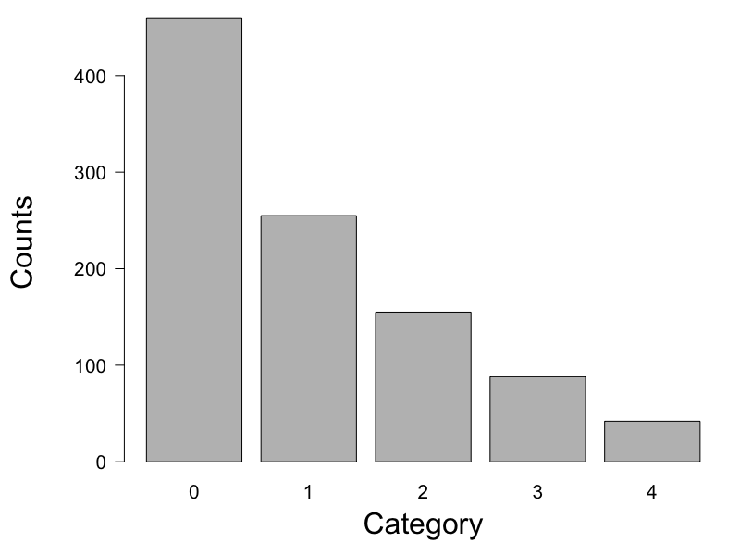
The Ordinal Markov Random Field
Marsman, M., van den Bergh, D., & Haslbeck, J. (2025). Bayesian Analysis of the Ordinal Markov Random Field. Psychometrika, 90, 146-182.

Slide 18
The Ordinal Markov Random Field
Marsman, M., van den Bergh, D., & Haslbeck, J. (2025). Bayesian Analysis of the Ordinal Markov Random Field. Psychometrika, 90, 146-182.

Slide 19
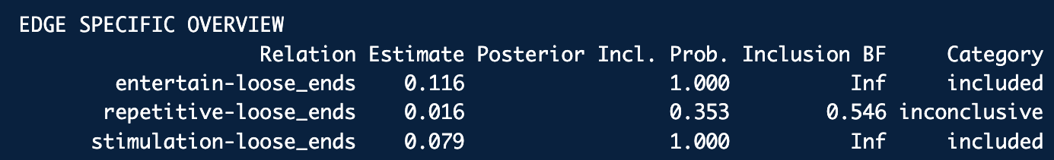
The Ordinal Markov Random Field
Marsman, M., van den Bergh, D., & Haslbeck, J. (2025). Bayesian Analysis of the Ordinal Markov Random Field. Psychometrika, 90, 146-182.

Slide 20
The Ordinal Markov Random Field
Conditional independence?
Marsman, M., van den Bergh, D., & Haslbeck, J. (2025). Bayesian Analysis of the Ordinal Markov Random Field. Psychometrika, 90, 146-182.

Slide 21
The Ordinal Markov Random Field
Conditional independence?
Marsman, M., van den Bergh, D., & Haslbeck, J. (2025). Bayesian Analysis of the Ordinal Markov Random Field. Psychometrika, 90, 146-182.

Slide 22
French and English-Speaking Samples
French (n = 496)
English (n = 490)
Martarelli, et al. (2023). A trait-based network perspective on the validation of the French short boredom proneness scale. European Journal of Psychological Assessment, 39(6), 390-399.

Slide 23
French and English-Speaking Samples
How could we assess sample differences?
French (n = 496)
English (n = 490)
Martarelli, et al. (2023). A trait-based network perspective on the validation of the French short boredom proneness scale. European Journal of Psychological Assessment, 39(6), 390-399.

Slide 24
French and English-Speaking Samples
How could we assess sample differences?
French (n = 496)
English (n = 490)
Martarelli, et al. (2023). A trait-based network perspective on the validation of the French short boredom proneness scale. European Journal of Psychological Assessment, 39(6), 390-399.

Slide 25
French and English-Speaking Samples
How could we assess sample differences?
Martarelli, et al. (2023). A trait-based network perspective on the validation of the French short boredom proneness scale. European Journal of Psychological Assessment, 39(6), 390-399.

Slide 26
French and English-Speaking Samples
French (n = 496)
English (n = 490)
Martarelli, et al. (2023). A trait-based network perspective on the validation of the French short boredom proneness scale. European Journal of Psychological Assessment, 39(6), 390-399.

Slide 27
Model the Difference in Edge Weight
French (n = 496)
English (n = 490)
Marsman, Waldorp, Sekulovski, & Haslbeck (2025). Bayes factor tests for group differences in ordinal and binary graphical models. Psychometrika, 90, 1809-1842.

Slide 28
Test the Difference in Edge Weight
Rather than testing whether an edge weight should be included or excluded (i.e., conditional independence), we now test if an edge difference should be included or excluded (i.e., edge invariance).
Marsman, Waldorp, Sekulovski, & Haslbeck (2025). Bayes factor tests for group differences in ordinal and binary graphical models. Psychometrika, 90, 1809-1842.

Slide 29
Test the Difference in Edge Weight
Rather than testing whether an edge weight should be included or excluded (i.e., conditional independence), we now test if an edge difference should be included or excluded (i.e., edge invariance).
Marsman, Waldorp, Sekulovski, & Haslbeck (2025). Bayes factor tests for group differences in ordinal and binary graphical models. Psychometrika, 90, 1809-1842.

Slide 30
Test the Difference in Edge Weight
Rather than testing whether an edge weight should be included or excluded (i.e., conditional independence), we now test if an edge difference should be included or excluded (i.e., edge invariance).
Marsman, Waldorp, Sekulovski, & Haslbeck (2025). Bayes factor tests for group differences in ordinal and binary graphical models. Psychometrika, 90, 1809-1842.

Slide 31
Test the Difference in Edge Weight
French (n = 496)
English (n = 490)
Marsman, Waldorp, Sekulovski, & Haslbeck (2025). Bayes factor tests for group differences in ordinal and binary graphical models. Psychometrika, 90, 1809-1842.

Slide 32
Classic vs Bayesian Network Comparison
Classic Approaches
Network Comparison Test (NCT)
Permutation-based test
Returns a p-value for rejecting equality
Fused Graphical Lasso (FGL)
Jointly estimates networks with penalization
Encourages similarity across groups
No inferential evidence for difference or invariance
Limitations
Asymmetry of evidence Can reject equality, but not support it
Multiplicity problems Edge-wise testing inflates false positives or requires harsh corrections
Visual fallacy Missing edges are often interpreted as “no difference”

Slide 33
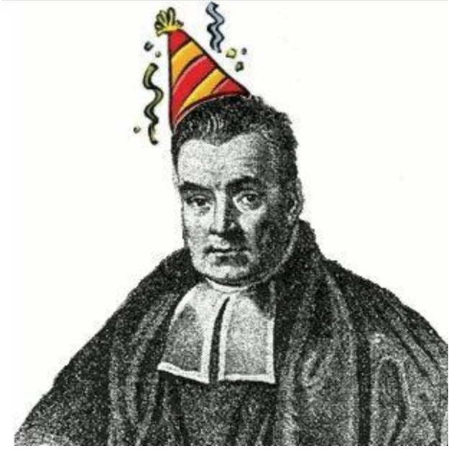
Classic vs Bayesian Network Comparison
Classic Approaches
Network Comparison Test (NCT)
Permutation-based test
Returns a p-value for rejecting equality
Fused Graphical Lasso (FGL)
Jointly estimates networks with penalization
Encourages similarity across groups
No inferential evidence for difference or invariance
Limitations
Asymmetry of evidence Can reject equality, but not support it
Multiplicity problems Edge-wise testing inflates false positives or requires harsh corrections
Visual fallacy Missing edges are often interpreted as “no difference”
Bayesian Approaches

Slide 34
Classic vs Bayesian Network Comparison
Classic Approaches
Network Comparison Test (NCT)
Permutation-based test
Returns a p-value for rejecting equality
Fused Graphical Lasso (FGL)
Jointly estimates networks with penalization
Encourages similarity across groups
No inferential evidence for difference or invariance
Limitations
Asymmetry of evidence Can reject equality, but not support it
Multiplicity problems Edge-wise testing inflates false positives or requires harsh corrections
Visual fallacy Missing edges are often interpreted as “no difference”
Bayesian Approaches
Advantages
Bayes factors
Quantify evidence for differences and for invariance
Model averaging
Can automatically correct for multiplicity
Posterior distributions and evidence plots
Make uncertainty explicit

Slide 35
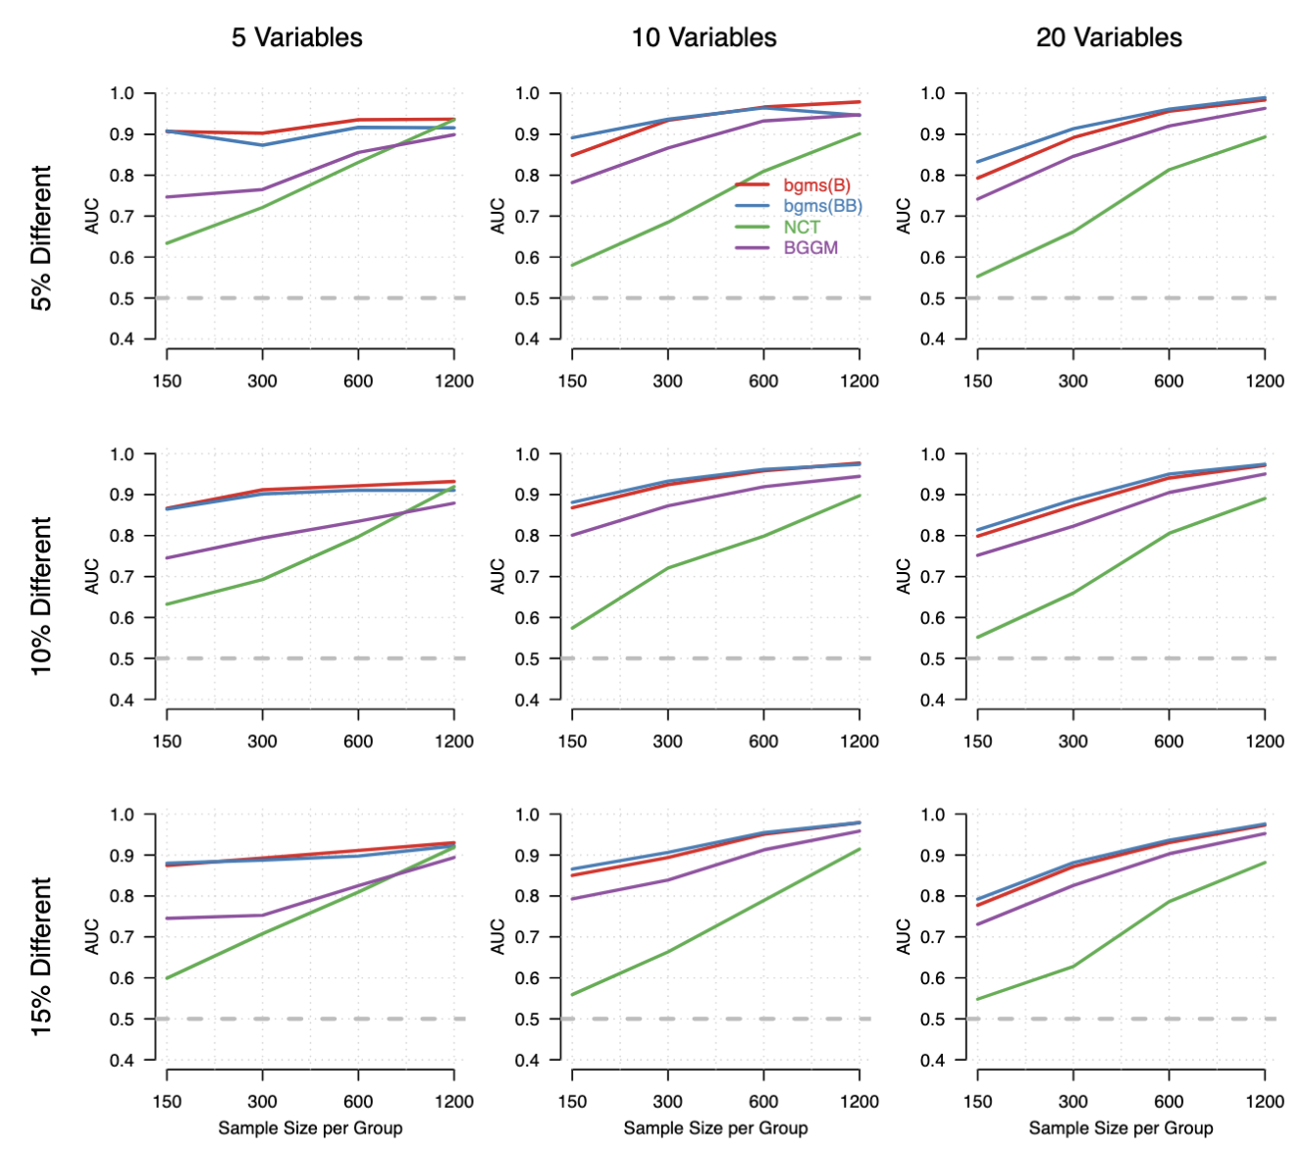
Simulation Evidence
Area under the ROC curve
Threshold-free summary of detection accuracy
0.5 = chance; higher = better
Design:
Variables: 5, 10, 20
Edge differences: 5–15%
Sample size: 150–1200 per group
Results:
Bayesian MRF methods perform best overall
Strong gains in small samples and low signal
NCT competitive with large samples & few variables
Marsman, Waldorp, Sekulovski, & Haslbeck (2025). Bayes factor tests for group differences in ordinal and binary graphical models. Psychometrika, 90, 1809-1842.

Slide 36
Session setup
Part I: Theory
Part II: Practical
Part III: Project
image: Flaticon.com

